Slide 1

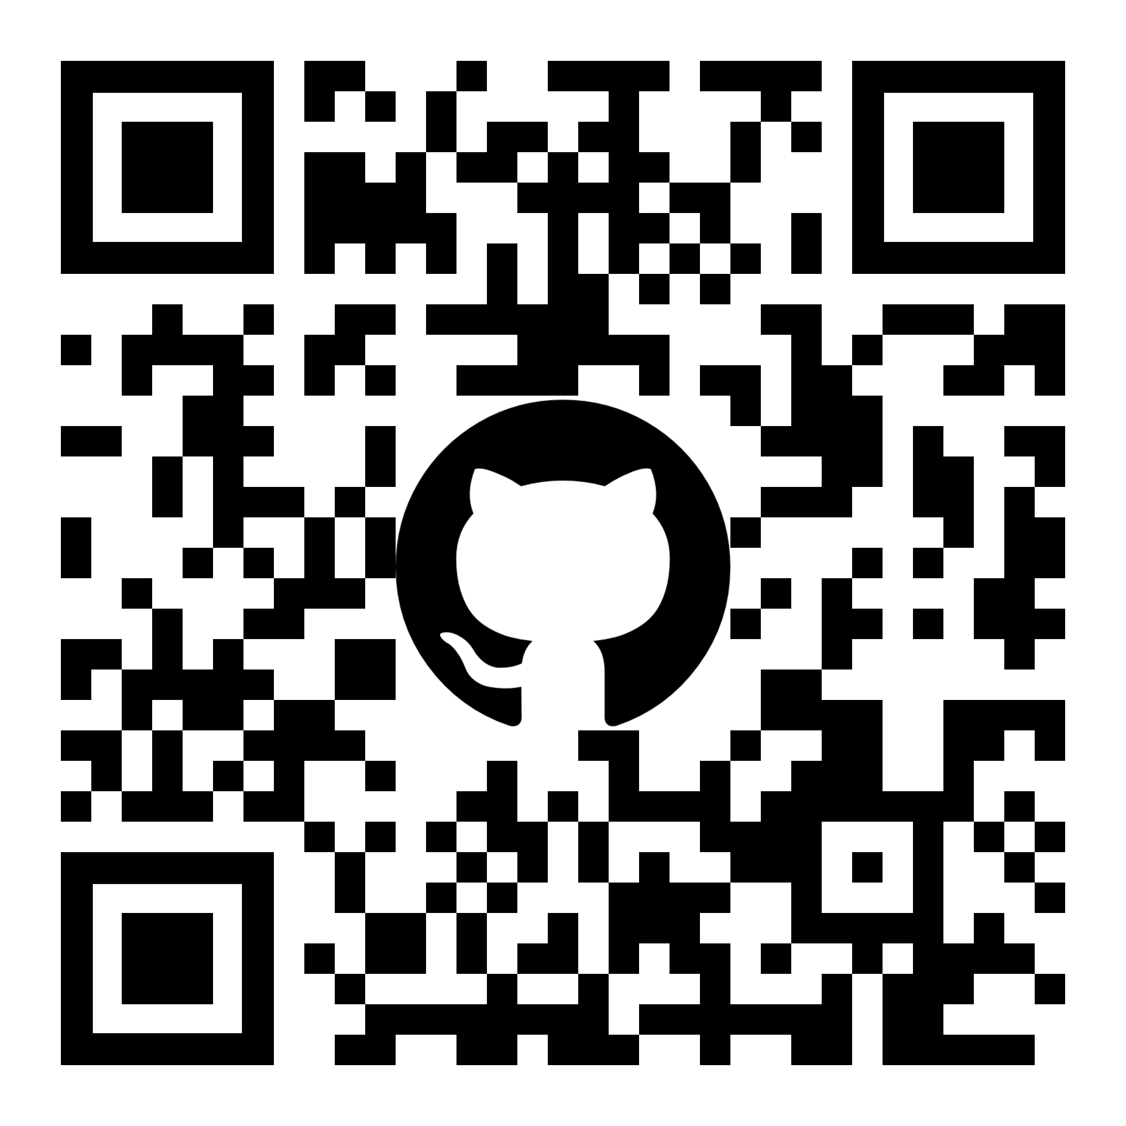
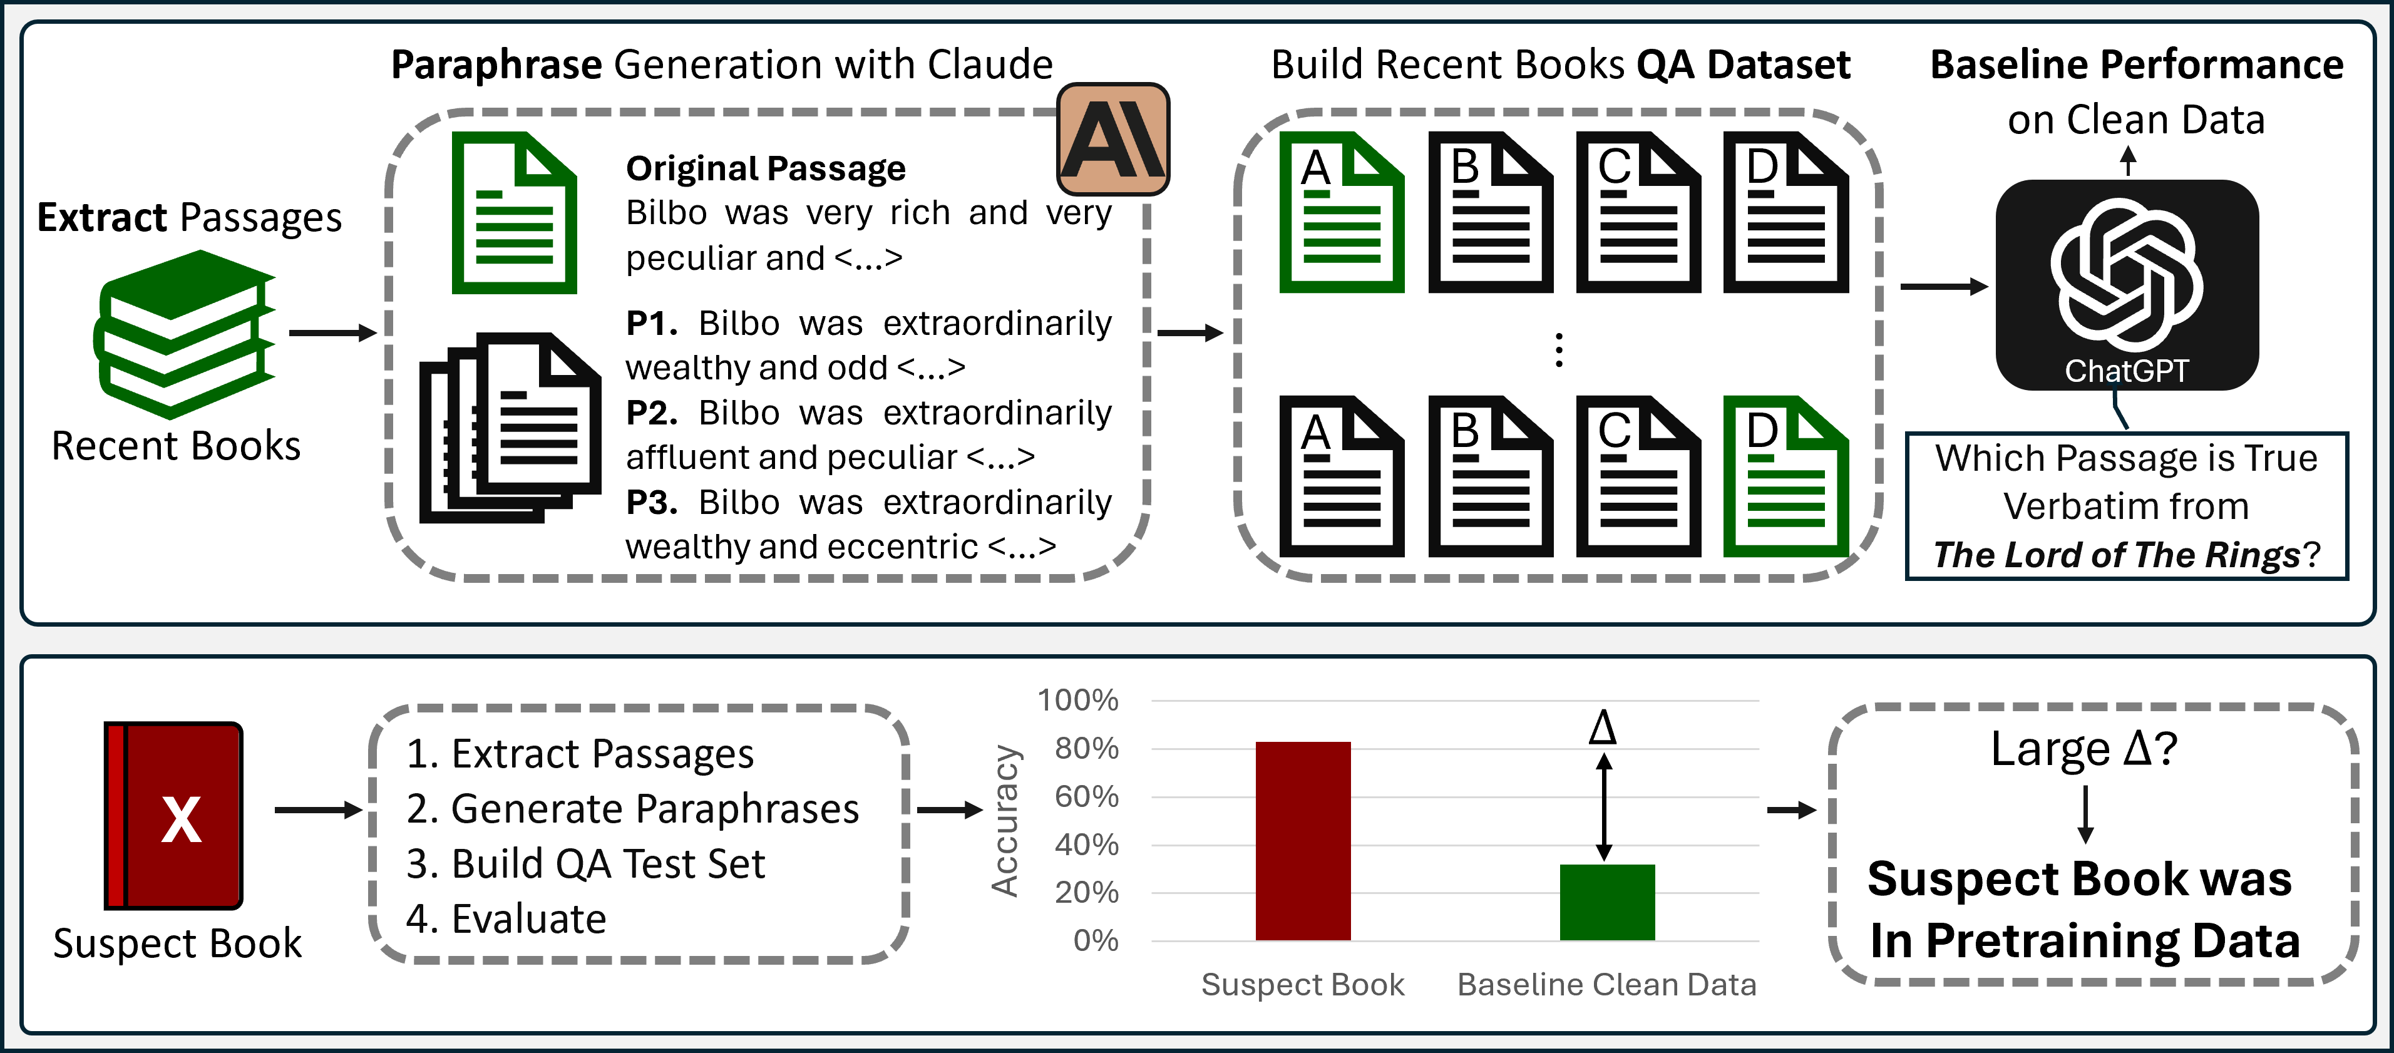
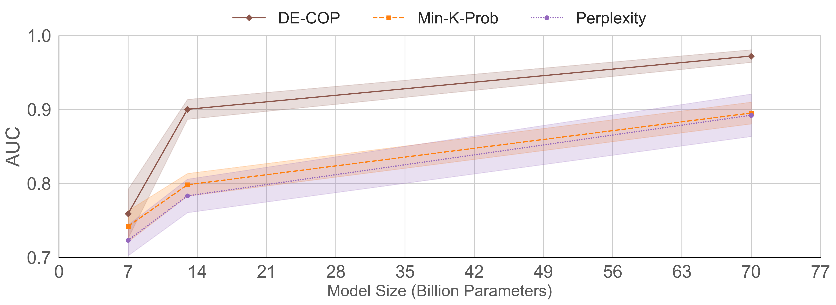
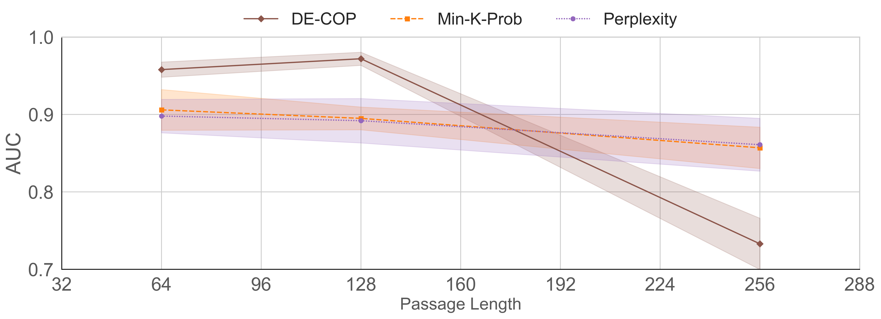

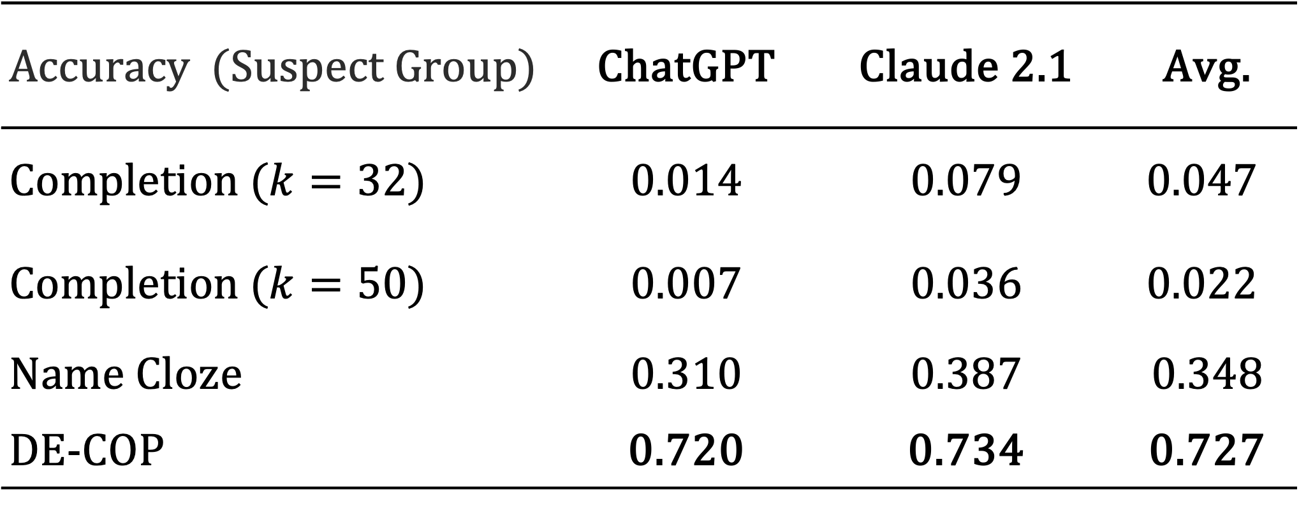
DE-COP: Detecting Copyrighted Content in Language Models Training Data André Duarte¹, Xuandong Zhao², Arlindo Oliveira¹, Lei Li³
Instituto Superior Técnico / INESC-ID¹, UC Santa Barbara², Carnegie Mellon University³
Overview
DE-COP Method
There is the suspicion that LLMs train on copyright protected data.
Companies do not disclose training data for competitive reasons, making it hard to verify the use of specific documents.
Most effective training data detectors need to use token probabilities $→$unsuitable for black-box models.
Premise: “A Language Model is likely to identify verbatim passages from its training data.”
Approach: Multiple-Choice Question-Answering task where the model is prompted to identify verbatim text from three other paraphrased options.
Goal: Models will correctly choose the exact text far more frequently when it is included in their training data, compared to when it is not.
Selection Bias Example
1.0
Book: The Hobbit
0.8
Selection Bias - Calibration
0.6
Accuracy
LLMs tend to prefer certain labels when performing Multiple-Choice QA tasks.
Open-Source models allow to modify token probabilities.
We exploit this feature to further reduce selection bias.
0.4
0.2
0.0
Average Value = 0.3733
Average Value = 0.7201
AUC | Mistral 7B | Mixtral 8x7B | LLaMA-2 13B | LLaMA-2 70B | GPT-3 | Avg.
Perplexity | 0.724 | 0.829 | 0.783 | 0.892 | 0.874 | 0.820
Zlib | 0.599 | 0.690 | 0.630 | 0.747 | 0.779 | 0.689
Lowercase | 0.846 | 0.889 | 0.880 | 0.927 | 0.957 | 0.900
Min-K%-Prob | 0.763 | 0.844 | 0.798 | 0.895 | 0.898 | 0.840
DE-COP | 0.901 | 0.968 | 0.900 | 0.972 | 0.863 | 0.921
Recent Books
Suspect Books
Accuracy (Suspect Group) | ChatGPT | Claude 2.1 | Avg.
Completion ($k=32$) | 0.014 | 0.079 | $$0.047$$
Completion ($k=50$) | 0.007 | 0.036 | $$0.022$$
Name Cloze | 0.310 | 0.387 | 0.348
DE-COP | 0.720 | 0.734 | 0.727
-
-
-
=
+
+
A
B
C
D
A
B
C
D
A
B
C
D
(1) Theoretical
(2) Observed
(3) Calibration
Proposed Benchmarks
DE-COP performance improves with Model Size.
DE-COP is influenced by the Passage Length.
Takeaways
📄 arXivTection: 50 arXiv Papers.
25 clean || 25 Suspect
📚 BookTection: 165 Books.
60 clean || 105 Suspect
Clean Data: Released 2023 onward.
Suspect Data: Released until 2022.
34 random passages extracted per document.
Passages paraphrased 3 times with Claude 2.0.
DE-COP proves to be an effective detection method for open and closed source models.
DE-COP is not only simpler to implement as it is, on average, better than all baselines.
Poor performance of the human evaluators in the book task supports our view that the models’ high accuracy is a consequence of being trained on these contents.
Logit Calibration allows us to increase the training vs non-training data threshold.
Average Human Score is near random guessing!
+0.5
Suspect Group Avg. = 0.27
Recent Group Avg. = 0.40
Global Avg. = 0.34
+0.3
+0.1
+0.3

